Slide 1
Hybrid Technique for Classification of Hyperspectral Image Using Quadratic Mutual Information
Arifa Islam Champa
Dept. of CSE, BAIUST, Comilla.
Md. Atikur Rahman
Dept. of CSE, UITS, Dhaka.
S. M. Mahedy Hasan
Dept. of CSE, RUET, Rajshahi.
Md. Fazle Rabbi
Dept. of CSE, IUT, Gazipur.

Slide 2
Outline
Introduction
Motivation
Objectives
Challenges
Literature Review
Methodology
Results
Conclusion

Slide 3
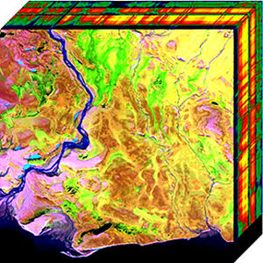
Introduction
Hyperspectral Images:
Collects and processes information across the electromagnetic spectrum where certain objects leave unique 'fingerprints‘
Spectral signatures enable identification of the materials
Figure 1: Two Dimensional Projection of Hyperspectral Cube[1]

Slide 4
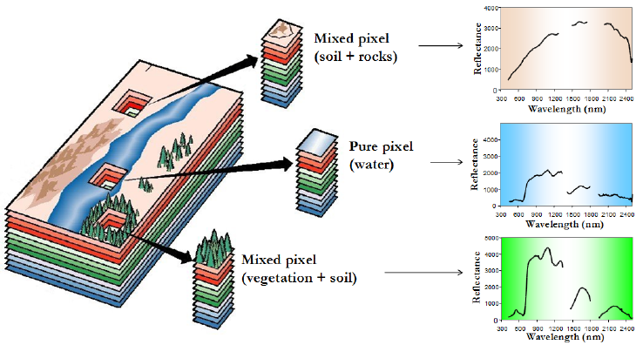
Motivation
Applications in astronomy, agriculture, biomedical imaging, geosciences, physics, surveillance, eye care, food processing, mineralogy, chemical imaging etc.
Widely used for ground cover classification problems
Figure 2: Mixture problem in hyperspectral data analysis[2]

Slide 5
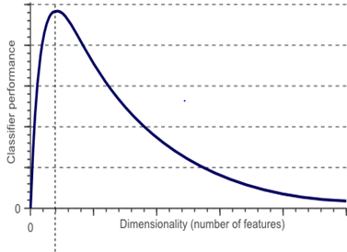
Challenges
Hughes Phenomenon:
If the size of the training data does not grow correspondingly with increment of feature space dimension, then classiﬁcation accuracy reduces
Also known as curse of dimensionality
Feature reduction to mitigate
Figure 3: Hughes Phenomenon[3]

Slide 6
Objectives
Extract only relevant features
Select most informative features
Evaluate efficient subspace detection technique

Slide 7
Literature Review
Feature Reuction:
High dimensional dataset transformed into low dimensional space
Done in two ways:
Feature Extraction:
Creates new features based on transformations
Feature Selection:
Selects best subset of the original feature set

Slide 8
Methodology
Input Hyperspectral Image
Feature Extraction Using PCA
Feature Selection using qMI
Classification Using KSVM
Figure 4: Flow chart of methodology

Slide 9
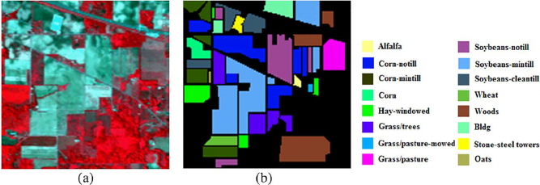
Implementation
Remote Sensing Data
Dataset: AVIRIS 92AV3C
Spectral: 0.4 µm-2.5 µm
Band: 220
Classes:16
Figure 5: AVIRIS 92AV3C Dataset[4] ((a) Ground Truth Image (b) RGB Image)

Slide 10
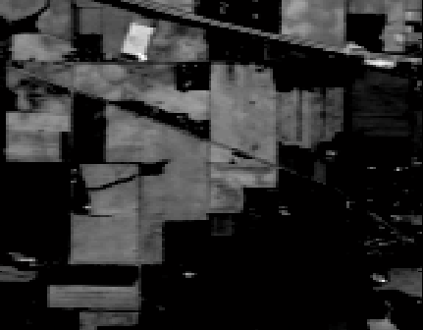
Feature Extraction
Principal Component Analysis(PCA):
Transforms highly correlated data set into new set of orthogonal uncorrelated variables
Figure 6 : Principal Components ( Left-PC1, Middle-PC7, Right-PC9) of AVIRIS Data

Slide 11
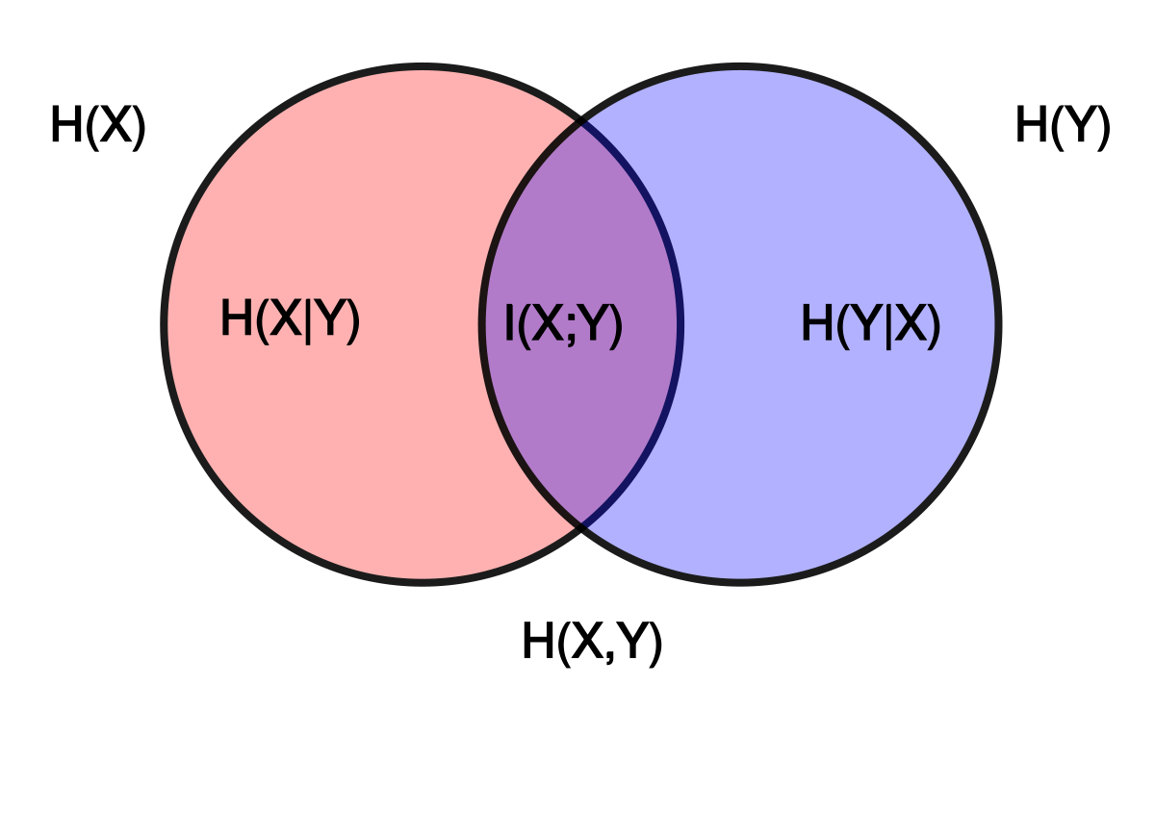
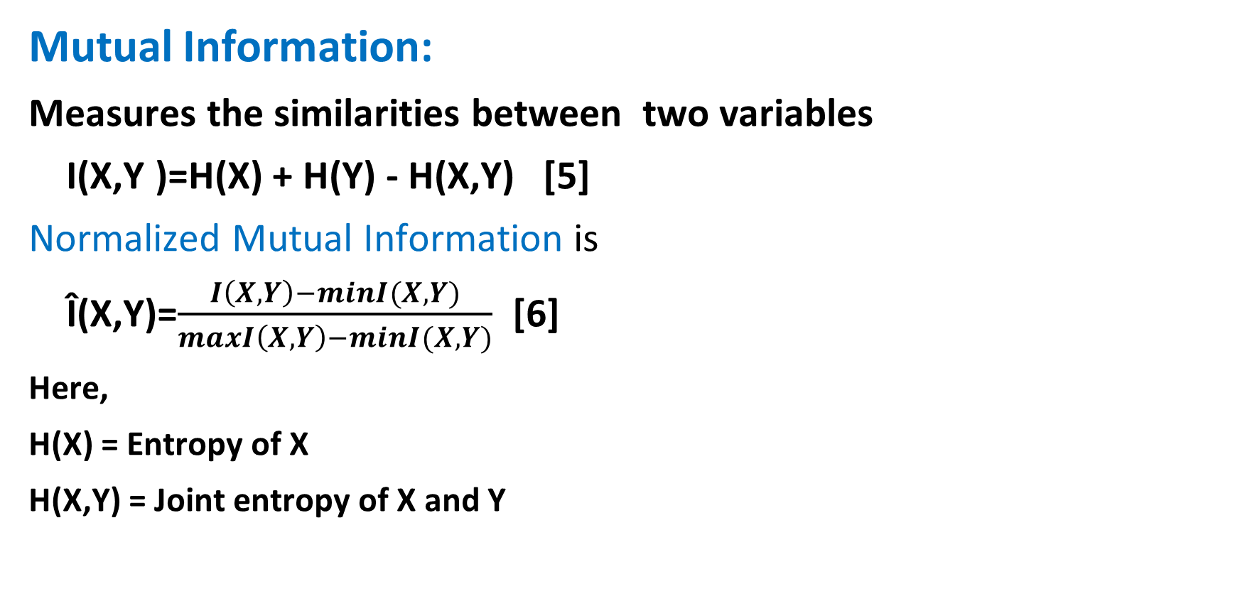
Feature Selection
Mutual Information:
Measures the similarities between two variables
I(X,Y )=H(X) + H(Y) - H(X,Y) [5]
Normalized Mutual Information is
Î(X,Y)=$\frac{I\left(X,Y\right)−minI(X,Y)}{maxI\left(X,Y\right)−minI(X,Y)}$ [6]
Here,
H(X) = Entropy of X
H(X,Y) = Joint entropy of X and Y
Figure 7 : Mutual Information[7]

Slide 12
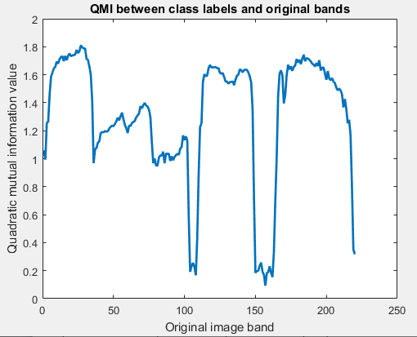
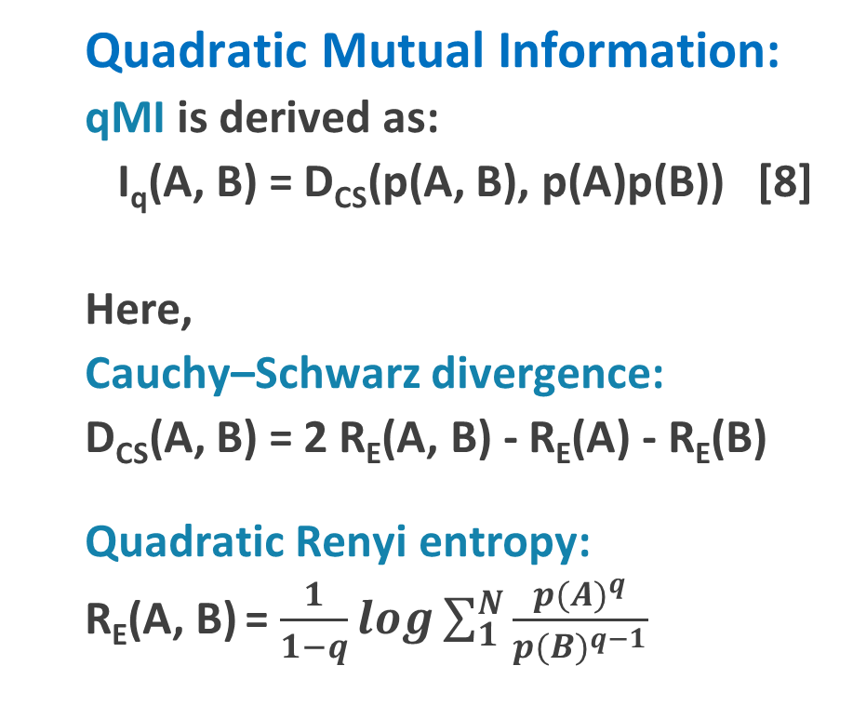
Feature Selection
Quadratic Mutual Information:
qMI is derived as:
I_{q}(A, B) = D_{CS}(p(A, B), p(A)p(B)) [8]
Here,
Cauchy–Schwarz divergence:
D_{CS}(A, B) = 2 R_{E}(A, B) - R_{E}(A) - R_{E}(B)
Quadratic Renyi entropy:
R_{E}(A, B) = $\frac{1}{1−q}log\sum_{1}^{N}{\frac{{p(A)}^{q}}{{p(B)}^{q−1}}}$
Figure 8 : qMI between class label and original image band

Slide 13
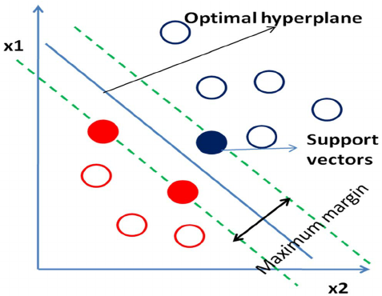
Support Vector Machine (SVM)
Supervised learning method
Used for classification and regression
Classifies complex data sets in higher dimensional space by constructing linear plane
Figure 9 : Representation of Support Vectors [9]

Slide 14
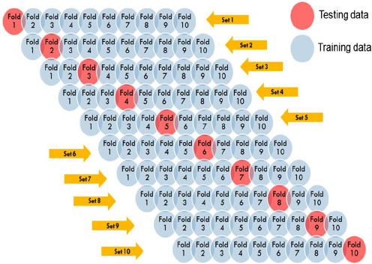
Cross Validation
10-fold cross validation:
Training set is divided into 10 equal sized sets
1 subset is tested using the classifier trained on the remaining 9 subsets
Figure 10 : 10-fold cross validation [10]

Slide 15
Classification Result
Table 1: AVIRIS 92AV3C Data
Class Name | Train data | Test data
Alfalfa | 12 | 12
Corn-notill | 49 | 40
Corn-min | 64 | 63
Corn | 30 | 20
Grass/Pasture | 86 | 70
Grass/Trees | 54 | 42
Hay-windrowed | 120 | 80
Soybeans-notill | 80 | 72
Soybeans-min | 135 | 88
Soybean-clean | 30 | 20
Wheat | 49 | 55
Woods | 156 | 121
Bldg-Grass-Tree-Drives | 25 | 20
Stone-steel towers | 24 | 18
Table 2: Classification Result
Data Sets | Cost(C) | Gamma(ϒ) | Accuracy
Original Data | 5 | 7.8 | 53.74%
PCA Data | 5 | 6 | 84.92%
PCA-qMI Data | 5 | 3 | 87.68%

Slide 16
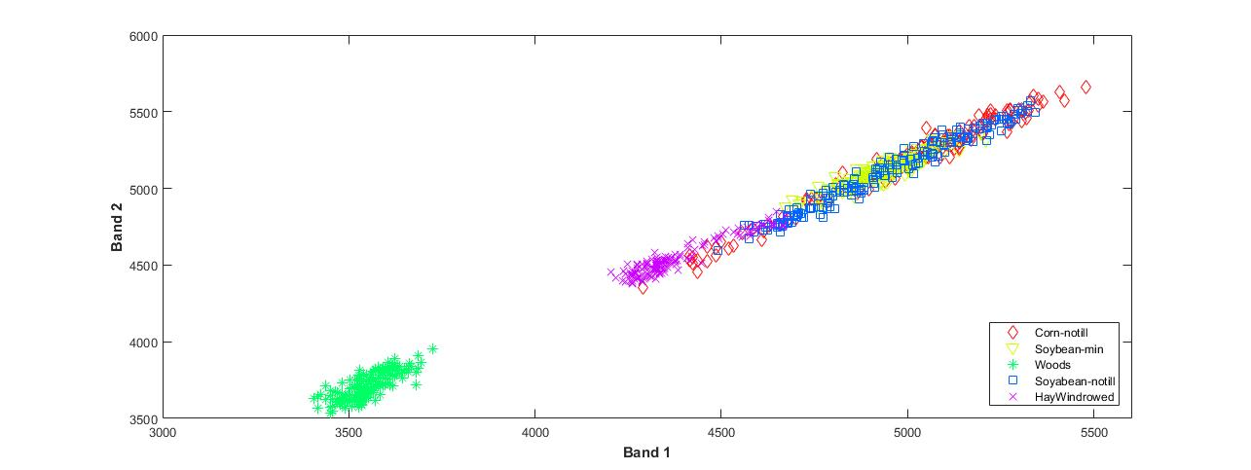
Classification Result
Figure 11 : Classification after applying MI

Slide 17
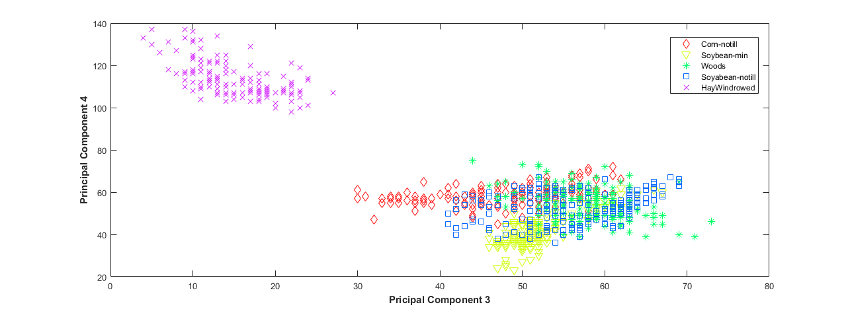
Classification Result
Figure 12 : Classification after applying PCA

Slide 18
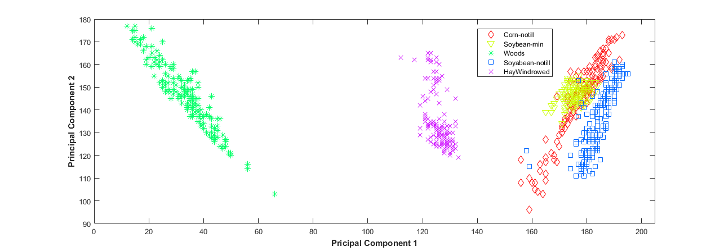
Classification Result
Figure 13 : Classification after applying PCA-qMI

Slide 19
Conclusion
Original data : 53.74%
PCA data : 84.92%
qMI-PCA data : 87.68%
Future Works:
Feature extraction using Kernel PCA
Introduce Adaptive Threshold

Slide 20
References
[1] | “Hyperspectral Image”, [Online]. Available: https://en.wikipedia.org/wiki/Hyperspectral_imaging/. [Accessed: 12-May-2020].
[2] | M.Ciznicki K.Kurowski and A.Plaza , “GPU Implementation of JPEG2000 for Hyperspectral Image Compression” Published in SPIE Proceedings, University of Extremadura, Spain, pp.8183 Oct 2011.
[3] | “The curse of dimensionality in classification”, [Online]. Available: http://www.visiondummy.com/2014/04/curse-dimensionality-affect-classification/. [Accessed: 12-May-2020].
[4] | D.A.Landgrebe. [Online]. Available: https://engineering.purdue.edu/biehl/MultiSpec/hyperspectral.html. [Accessed: 12-May-2020].
[5] | E. G. Learned-Miller, “Entropy and Mutual Information, ” Department of Computer Science, University of Massachusetts, Amherst, September 16, 2013.

Slide 21
References
[6] | A. I. Champa, M. F. Rabbi, and N. Banik, “Improvement in Hyperspectral Image Classification By Using Subspace Detection Technique,” International Conference on Sustainable Technologies for Industry 4.0 (STI), Dhaka, Bangladesh, 23-24 December, 2019.
[7] | “Mutual Information”, [Online]. Available: https://en.wikipedia.org/wiki/Mutual_information#/media/File:Entropy-mutual-information-relative-entropy-relation-diagram.svg. [Accessed: 12-May-2020].
[8] | S. Z. Mishu, M. A. Hossain and B. Ahmed, “Hybrid sub-space detection technique for effective hyperspectral image classification,” in 2018 International Conference on Computer, Comunication, Chemical, Material and Electronic Engineering. IEEE, 2018.
[9] | “Support vector machine,” [Online]. Available: https://www.researchgate.net/figure/268232391fig5Figure-5-Hyperplane-blue-line-representation-in-SVM-Red-and-blue-circles-represent. [Accessed: 12-May-2020].
[10] | “10 fold crosss validation,” [Online]. Available: https://www.researchgate.net/figure/. [Accessed: 12-May-2020].

